Slide 1

Team 10: Zach Fulton, Nolan McDermott, Talon Smith

Slide 2



OneStat summary:
Baseball for All
wRC+
Name: Weighted Runs Created Plus
Scale: 100 is average
150 is 50% above average
50 is 50% below average
Last Year’s Leader:
Juan Soto - 212 (112% above average)
Example: All Soto’s 2020 Home Runs
Our take: wRC+ is a great and easy to understand stat for rating offensive performances. Similar to OPS+ but used wOBA so it better represents walks vs singles.
Player Comparisons, Stat leaderboards,
Statistical definitions, WARLeagues, etc
Enter Player 1:
Choose Season:
Enter Player 2:
Amed Rosario
Francisco Lindor
OneStat
rWAR
fWAR
xwOBA
OAA
Amed Rosario
SS
LHH
25
Name
Position
Handiness
Age
Francisco Lindor
SS
SH
27

Slide 3
System overview
Three-tier architecture
Client server as the UI Tier
Python Backend that organizes and communicates data as the middle tier
OneStat database as the storage tier
These three tiers will interact in order to provide the general users on the UI Tier with a quick and easy experience
Actors:
Client server will be used by general users including WarLeague members and owners
All three tiers will be used by the system managers in order to maintain and update the program and databases

Slide 4
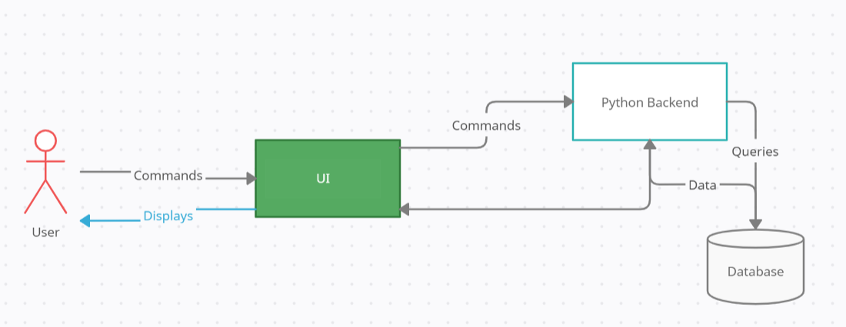
System’s components w/ system diagram

Slide 5
Actor Identification
General User
Accesses OneStat from their homes
Very limited access to the software
WarLeague Owner
Can invite users to their league and manage it
Has access to edit the league and manage the league and its players
WarLeague Member
Can join a league
Chooses players to use and can compete
Has less access than the league owner
System Manager
Verifies server information
Updates definitions
Assists general users
Significantly more access than general users

Slide 6
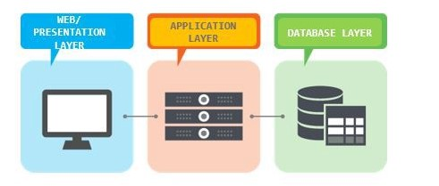
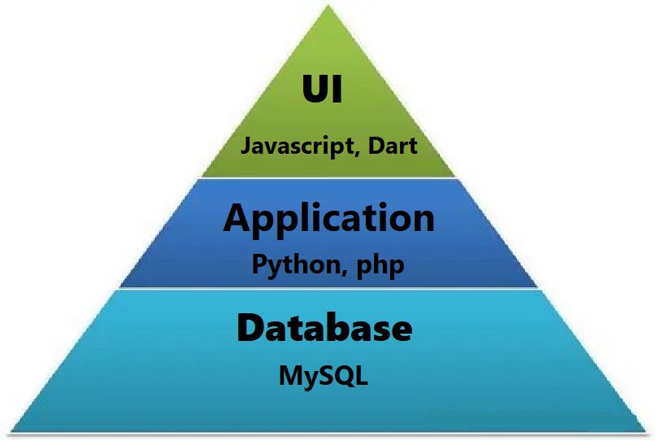
Architectural Style
Three Tier Structure
OneStat Database
Stores
Definitions
Leaderboards
Player Data
Python based middle tier
Retrieves requests from user
Implement processes to retrieve data from database and send to user
Client UI
Displays requested information neatly with OneStat’s user interface

Slide 7
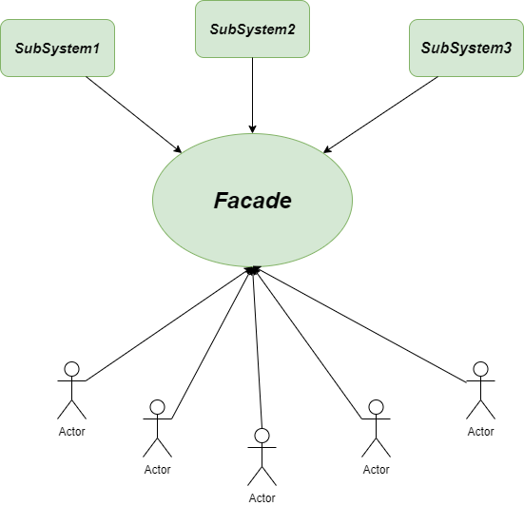
Design patterns
Façade
To allow for the complex organization of the system to be organized and stable when an actor is using it.
Since there are multiple types of users it can distinguish be them and provide different levels of access for users
Creates a false image that the system is simple when in reality it is very complex

Slide 8




Frameworks
User framework
HTML, CSS, JavaScript for desktop
React framework for Javascript
Dart for mobile
Middle tier
Python to retrieve data and inputs from the other tiers and process requests
Database
MySQL to organize and store data securely
Allows quick access and editing

Slide 9
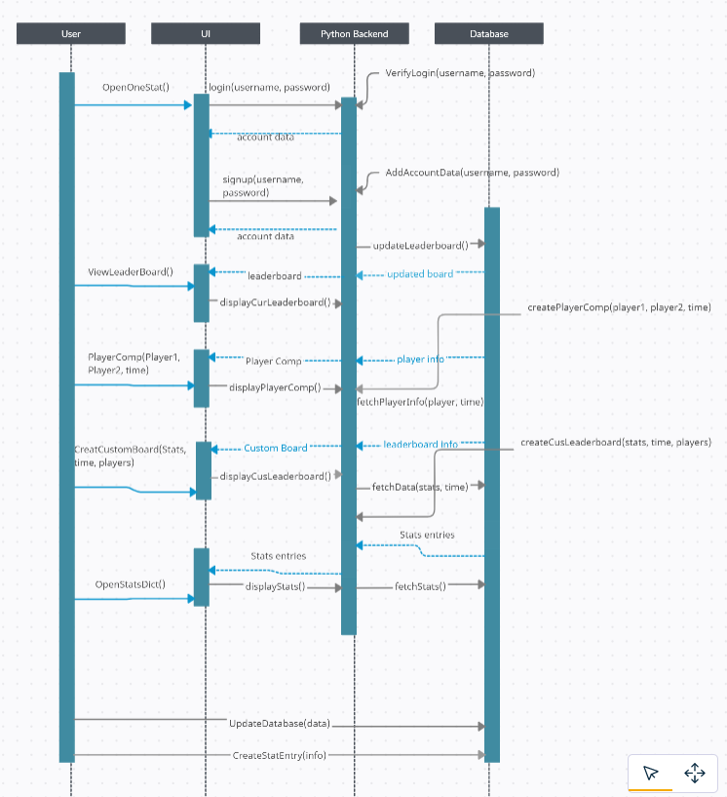
Sequence Diagram
OneStat

Slide 10
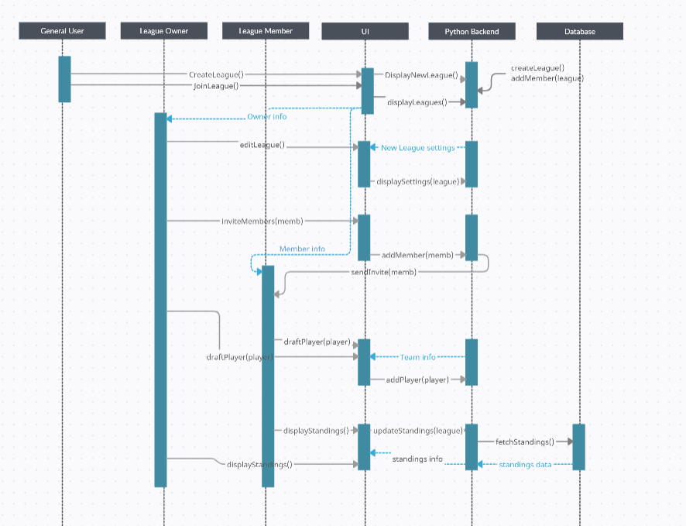
Sequence Diagram
WARLeagues

Slide 11
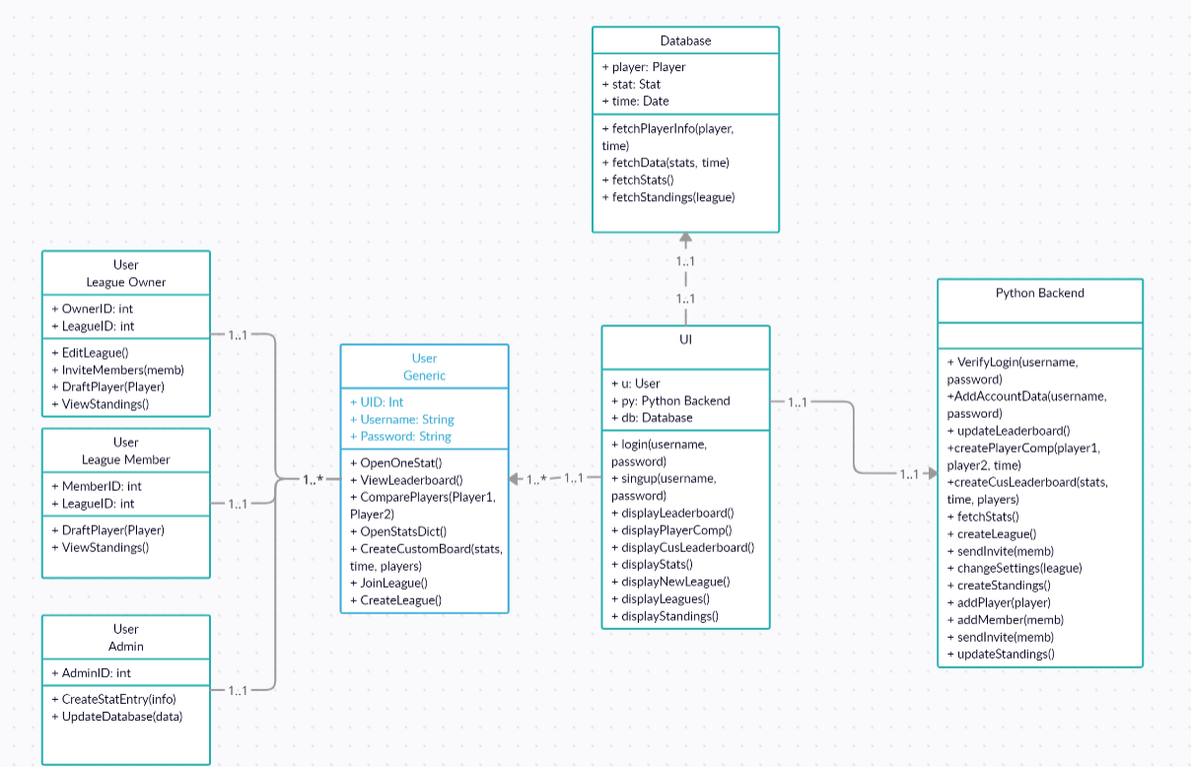
Class Diagram

Slide 12


GitHub Link: https://github.com/NolanMcD/CSC431

